Slide 1


Tiki-Taka: Analyze, Plan, Win
Tiki-Taka helps coaches analyze opponents, create tactical plans, and visualize the best lineup using AI and automation.

Slide 2



AgeNTT Team
Tiki-Taka Project
Ahmet Kaplan
Emre Kemal Balcı
Senior Software Engineer
@NTT Data Business Solutions Türkiye
ahmet11.kaplan@nttdata.com
kaplanahmet30@gmail.com
RPA Group Manager
@NTT Data Business Solutions Türkiye
emre.balci@nttdata.com
emrekemalbalci@hotmail.com

Slide 3
Problem statement and proposed solution
Problem
Solution
Football teams and analysts must review large amounts of match, player, and opponent data before every game.
Tactical preparation is often manual, time-consuming, and depends heavily on analyst experience.
Opponent analysis, tactical planning, and lineup updates are usually disconnected steps across different tools.
Coaches need faster, data-driven insights to turn opponent weaknesses into actionable tactical decisions.
Tiki-Taka uses UiPath Apps, Data Fabric, Maestro, and AI Agents to automate football match preparation.
OpponentScout Agent analyzes match, team, player, and historical data to generate opponent insights and risk score.
TacticalPlanner Agent converts the opponent analysis into a tactical plan with formation, game model, and tactical instructions.
LineupCoordinator Agent updates HomeTeam player positions based on the recommended formation and visualizes the lineup in the app.

Slide 4
Benefits and technologies used
Benefits, impact and outcomes
End-user​ | Football Coaches, Match Analysts, Technical Staff
User department​ | Football Operations, Match Analysis, Coaching Team
Industries​ | Sports, Football Clubs, Sports Analytics
UiPath products used​ | UiPath Apps, UiPath Maestro, UiPath Agents, Data Fabric, Studio Web
Other - integrations / APIs / technologies used​ | Custom HTML, JavaScript, Structured Entity Modeling, AI Agent Workflows
Reduces manual match preparation by connecting opponent analysis, tactical planning, and lineup updates in one workflow.
Helps coaches turn structured football data into actionable tactical decisions faster.
Improves lineup consistency by automatically mapping players to the recommended formation.
Provides a visual, demo-ready experience with pitch view, bench list, risk score, and tactical insights.

Slide 5
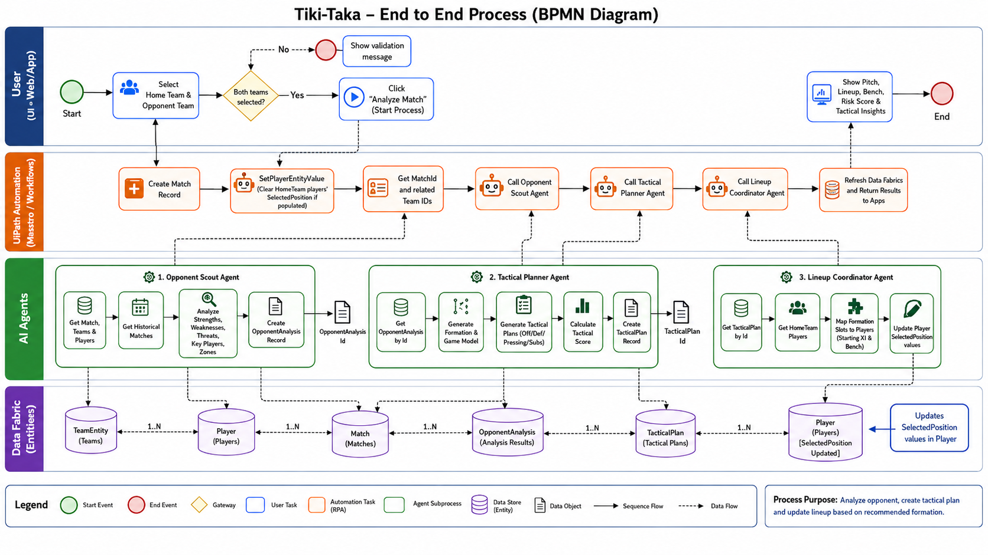
Solution architecture

